Slide 1
HVAC Factory Supply Chain Report
By: Mostafa Abdelmohsen

Slide 2
Agenda
Introduction
Data & Method
Inbound Performance
Outbound Performance
Production Efficiency & Losses
Recommendations, Gaps & Next Steps

Slide 3
Introduction
What this report covers ?
  KPI performance (OTIF Inbound/Outbound, Scrap Rate, Downtime)
  Loss hierarchy & top causes
  Actionable insights and next steps

Slide 4
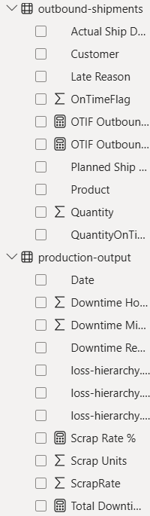
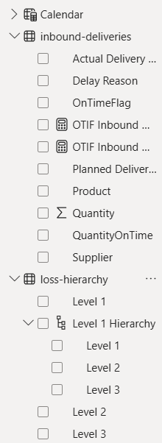
Data & Method
Datasets
  Inbound Deliveries (supplier, planned vs actual, delay reason)
  Production Output (units, scrap, downtime minutes, reason)
  Outbound Shipments (customer, planned vs actual, late reason)
  Loss Hierarchy (Level 1 → Level 2 → Level 3)
Model & Approach
  Star schema with a shared Calendar dimension
  Power BI for KPIs & interactive visuals; Python for EDA checks
  OTIF “on time” rule: Actual date ≤ Planned date
  Downtime Minutes converted to Total Downtime Hours

Slide 5
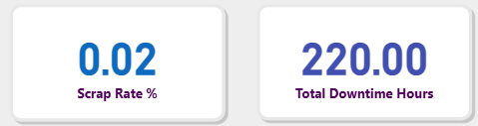
KPI Overview & Definitions
Key KPIs
  OTIF (Count): % of orders delivered/shipped on time
  OTIF (Quantity): % of units delivered/shipped on time
  Scrap Rate: Scrap Units / (Units Produced + Scrap Units)
  Total Downtime Hours: Sum(Downtime Minutes) ÷ 60
Headline Numbers
  Scrap Rate: 0.02% (very low)
  Total Downtime Hours: 220 h

Slide 6
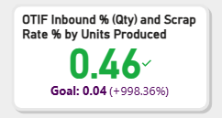
Inbound Performance
KPI Focus: OTIF Inbound (Quantity) + Scrap Rate per Unit Produced = 0.46
What it means
  Low ratio → timely, high‑quality incoming materials
  Fewer input‑related defects; reduced rework and scrap
Drivers & Evidence
  Strong supplier adherence to due dates
  Stable incoming quality (correlated with low scrap)
Actions
  Lock‑in top suppliers (scorecard, preferred status)
  Share feedback/targets with mid‑tier suppliers
  Maintain incoming QC sampling; monitor for drift

Slide 7
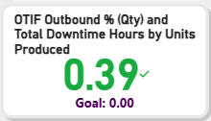
Outbound Performance
KPI Focus: OTIF Outbound (Quantity) + Downtime Hours per Unit Produced = 0.39 (Green)
What it means
  Minimal downtime burden per unit → stable scheduling
  Strong production‑to‑logistics handoff
Drivers & Evidence
  Fast recovery from breakdowns
  Tight collaboration between production planning & shipping
Actions
  Publish a daily “OTIF risk” board (orders at risk, mitigations)
  Standardize pre‑shipment checks (pick/pack readiness)
  Keep a short list of expediting options for peak days

Slide 8

Production Efficiency & Losses
KPI Cards
  Scrap Rate: 0.02% → best‑in‑class quality
  Total Downtime: 220 h → still a savings opportunity
Loss Analysis (use Loss Hierarchy drill‑down)
  Pareto top contributors at Level 1 → drill to Level 2/Level 3
  Identify few vital causes driving most downtime
Actions
  Target a 10% downtime reduction → +2 production days/month
  Sustain via weekly review: actual vs target loss tree

Slide 9
Recommendations, Gaps & Next Steps
Quick Wins
  Supplier scorecards & feedback loops (inbound)
  Daily OTIF risk board + pre‑shipment checklist (outbound)
  Two kaizen events addressing top downtime causes
Data/Tooling Improvements
  Capture inventory on‑hand snapshots → compute DOH
  Normalize delay reasons to the loss hierarchy for easier mapping
  Add automated alerts when OTIF dips below threshold
Roadmap (Optional ML)
  Predict next‑week OTIF from planned mix & past delays
  Classify late reasons from text to standardized categories

Slide 10
Thank You

